Slide 1

Software Engineering
Gruppo 9 – Drawing App
Lorenzo Mignone - 0622701866
Artemis Ostadimitris - 0622701874
Gaetano Parolise - 0622701919
Davide Parente - 0622701859

Slide 2
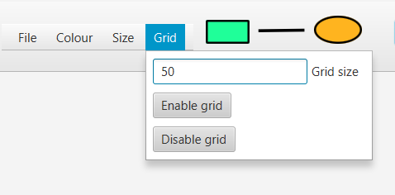
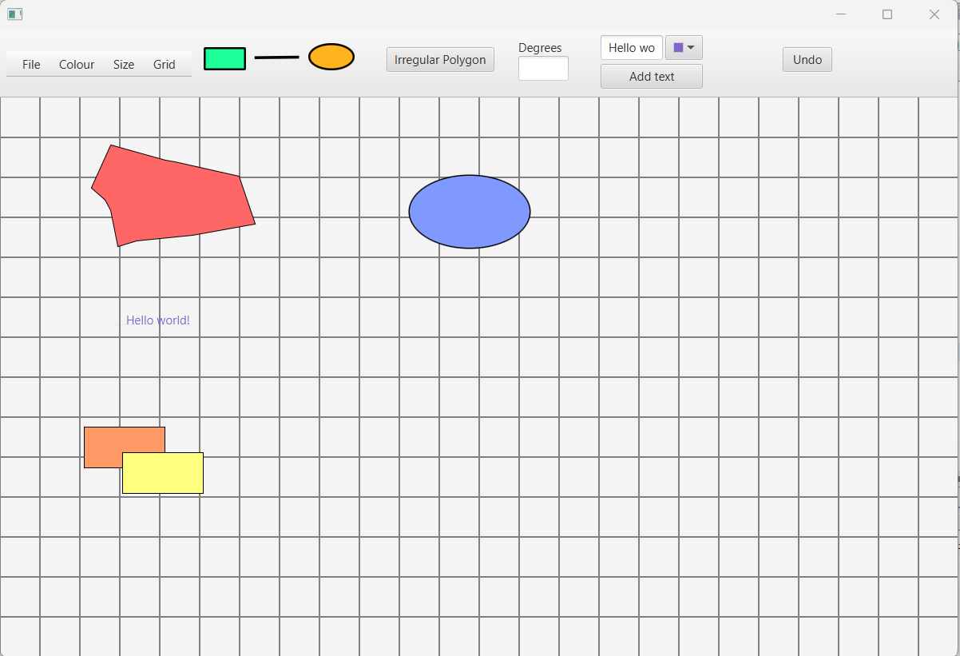
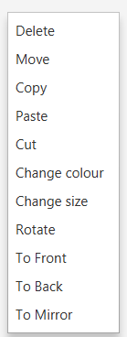
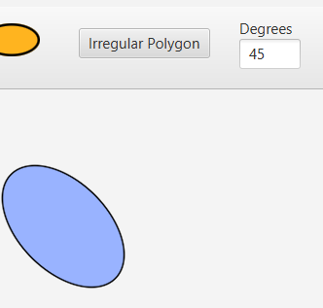
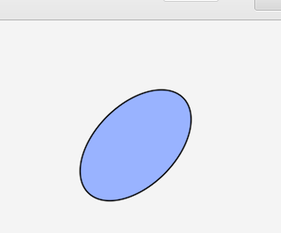
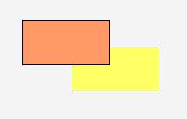
Sprint 3 - Release
Achieved goals:
Layering function
Overlapping of shapes
Scroll bars
Grid
Zoom function
Rotate function
Creation of text shapes
Creation of irregular polygons
Rotation of 45 degrees
Mirroring
To front of the orange rectangle

Slide 3
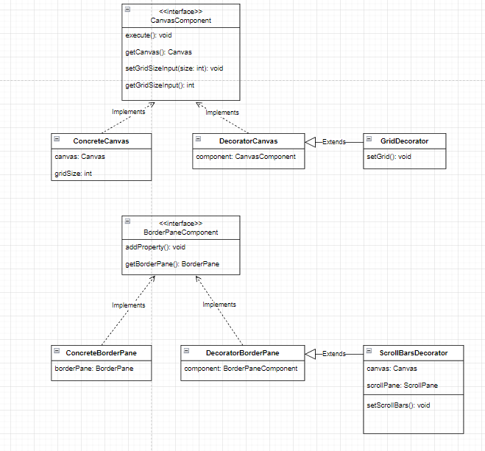
Patterns used – Decorator

Slide 4
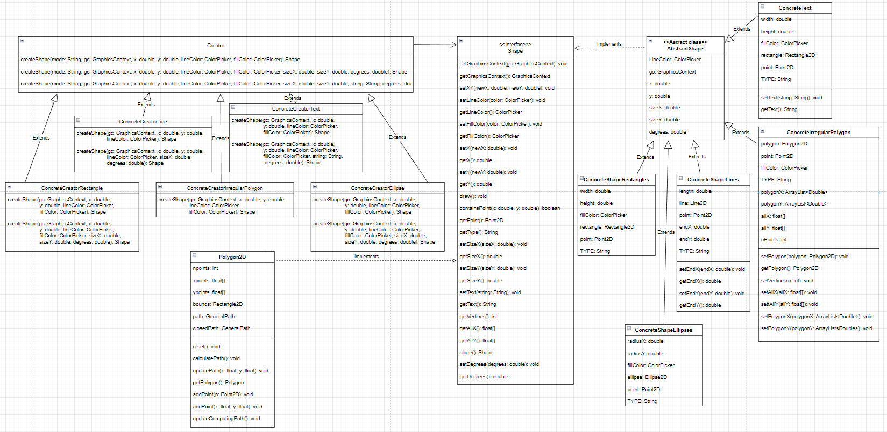
Patterns used – Factory Method

Slide 5
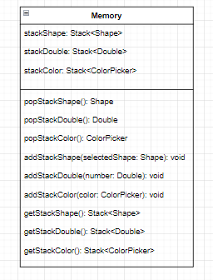
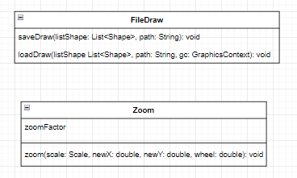
Package Functions
Package Memory

Slide 6
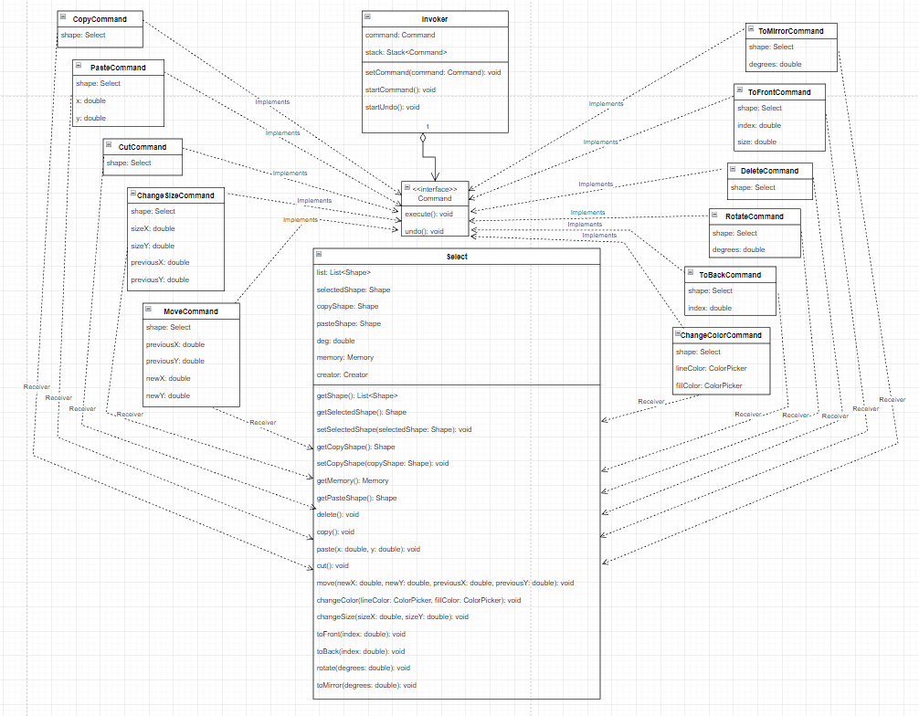
Patterns used – Command

Slide 7

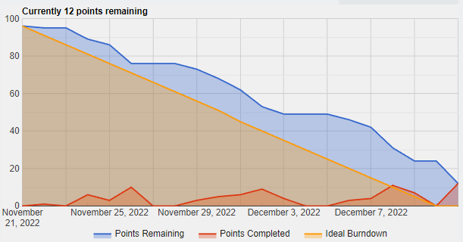

Sprint Review
Team velocity
Estimated a priori velocity: 49 SP
Estimated retrospectively velocity: 37 SP
Problems detected
Overlapping problems
Operation of change size cannot be performed on text shapes and irregular polygons
Operation of move cannot be performed on irregular polygons

Slide 8
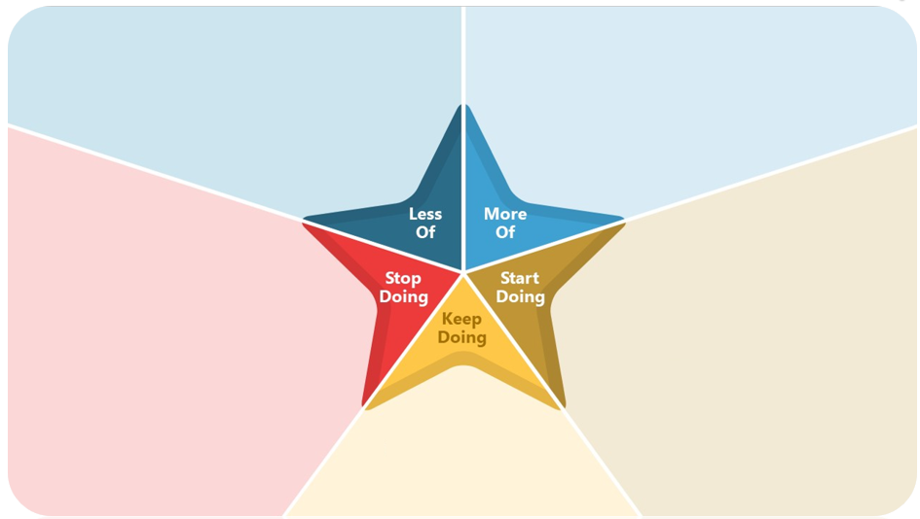
Retrospective
Nothing
Nothing
Nothing
Nothing
Continue doing meetings
Continue doing code review by all members
Raise issues during daily meetings
Comment out code

